Slide 1
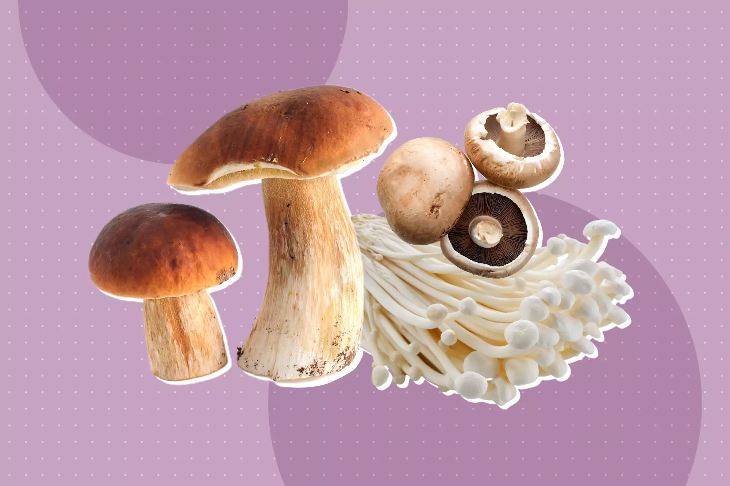

Edible or Poison?
Mushroom Classification using Key Characteristics
Andrea Cruz
Data Mining Project – DTSA 5506
Notes:
Hello, welcome to my data mining project as part of the Data Mining Project Course for the Master’s in Data Science program at University of Colorado, Boulder. My name is Andrea Cruz and my project is entitled “Edible or Poison? Mushroom Classification using Key Characteristics”

Slide 2
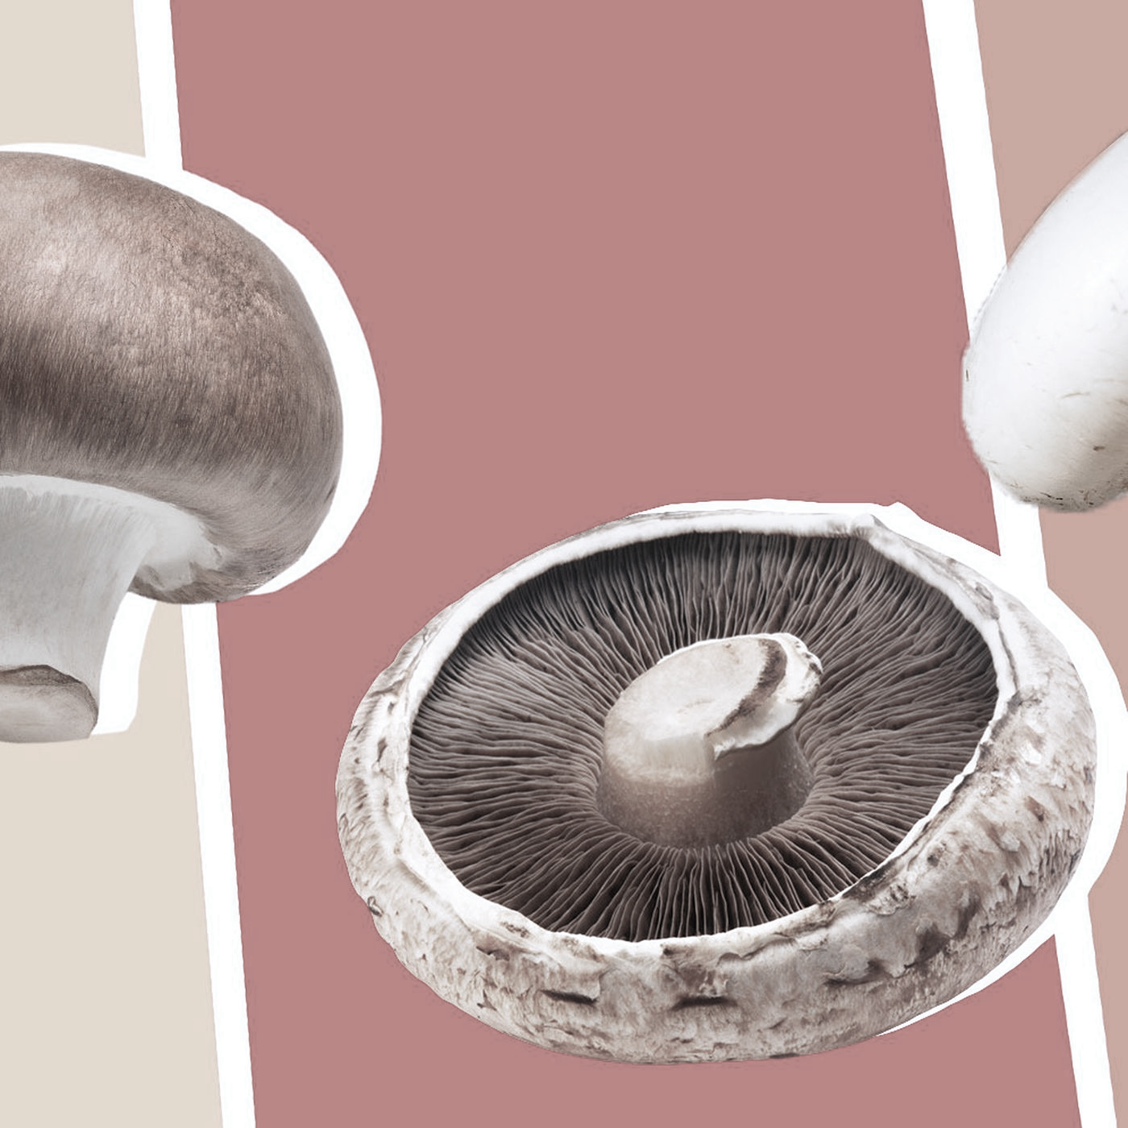
Problem Statement
Mushrooms are a widely popular fungi for consumption. However, while some can be delicious, some can also be very poisonous. One minor characteristic can be the difference between life and death. With the increasing interest in outdoor foraging, it is imperative to have a reliable classification system for individuals to utilize in their excursions to keep themselves safe.
Notes:
For some background regarding this project, mushrooms are a widely popular type of fungi that most people are familiar with seeing in local grocery stores or even as a delicious topping on their favorite pizza. In recent years, with the effects of the pandemic and the need for distanced activities, there has been a shift in interest towards outdoor activities. Ever growing in popularity, especially, is the foraging of edible mushrooms. Unfortunately, high stakes accompany this type of foraging as a deadly poisonous mushroom can be one minor characteristic from being mistaken as an edible species. It is imperative to have a reliable classification system for foragers to utilize in the excursion to keep themselves safe.

Slide 3
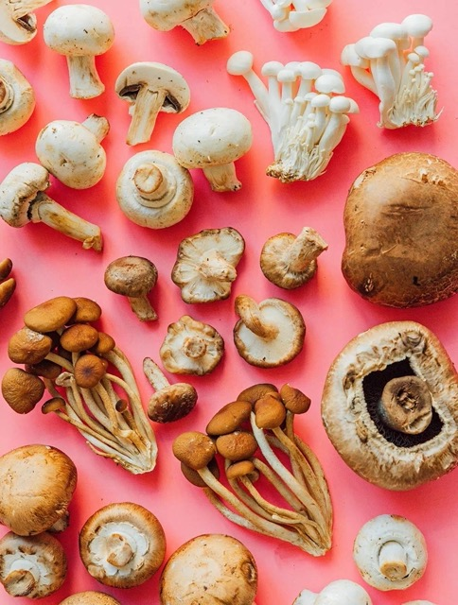
Executive Summary
This project aimed to develop a model that will help automate the classification of mushroom species. The mushroom dataset, obtained from the UCI Machine Learning Repository, was split into training and test subsets and multiple classification models were implemented for identifying mushrooms as edible or poisonous. During a method comparison for efficiency and accuracy, a Decision Tree Model was determined to be the most viable model for the purposes of this project.

Slide 4
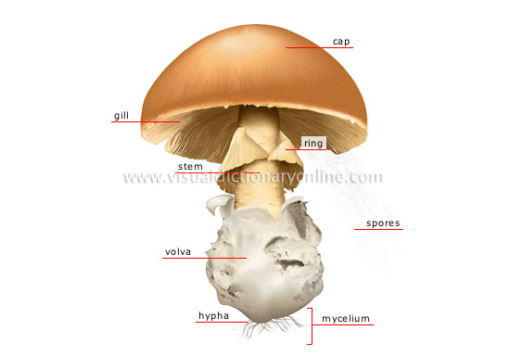
Mushroom
Anatomy
Notes:
Some additional background knowledge regarding the anatomy of mushrooms will greatly supplement the understanding of this project due to the structure of the dataset acquired. All attribute columns of the dataset are categorical assignments based on the anatomical parts listed in this diagram.
Mushrooms are the fruiting bodies of an underground networking organism called mycelium. From the ground up, the most visible parts of the mushroom, and subsequently the attributes that are used for identification…

Slide 5
Mushroom
Anatomy
Notes:
…include the “stem”…

Slide 6
Mushroom
Anatomy
Notes:
…the “ring” or “veil”…

Slide 7
Mushroom
Anatomy
Notes:
…the ”gills”…

Slide 8
Mushroom
Anatomy
Notes:
…the “cap”…

Slide 9
Mushroom
Anatomy
Notes:
And finally, the reproductive “spores”.

Slide 10
Proposed Work
Dataset was obtained from UCI Machine Learning repository.
Preprocessing and initial analysis was performed to identify any obvious patterns.
Decision Tree, Random Forrest, and Naïve Bayes classification models were implemented.
Models were evaluated against Test dataset for accuracy and efficiency.
Notes:
For this classification project, the proposed work was executed as follows:
The Dataset was obtained from the UCI Machine Learning Repository
Preprocessing and initial analysis was performed to identify any obvious patterns that could aid with classification. As part of this preparation, the dataset was split into “Training” and “test” subsets in an 80:20 proportion to prevent possibilities of overfitting.
After data was prepared, 3 classification models were implemented using a machine learning python library called SciKit-Learn. Decision tree, Random Forrest, and Gaussian Naïve Bayes Classification were the models implemented.
Lastly, models were evaluated against the test dataset for accuracy and efficiency and their performances were evaluated comparatively to determine the best fit model for this problem.

Slide 11
Related Works
Different methods were used to identify the most relevant attributes as it relates to the classification of “edible” or “poisonous.” (Wrapper, Filter, Correlation)
Multiple classifications methods were implemented and evaluated for predictive accuracy. Two groups identified the most efficient classification method as Decision Tree Induction
Notes:
During the data understanding step of the data mining process several related projects were identified to evaluate different strategies and tools used for this problem.
Vanitha et al compared two different methods (Wrapper and Filter) to identify the most relevant attributes as it to the classification of “edible” or ”poisonous” mushrooms. Author Tank used attribute correlation analysis to do the same.
Projects executed by both Tank and Foltz & Dakshin implemented multiple classification models and evaluated for predictive accuracy. Two groups identified the most accurate method as Decision Tree Induction.
This project aims to build on previous conclusions by utilizing comparative methods to evaluate the identification of the key attribute, accuracy, and efficiency of models implemented.

Slide 12
Data Preprocessing
Attribute Veil-type removed
Categorical data encoded into continuous numeric values for use in SciKit-Learn
Dataset split into Training and Test subsets, in 80:20 proportion
Notes:
During the preprocessing step, standard data cleaning was performed with these results as the main takeaways.
The Attribute of “Veil-type” was identified to have only 1 unique value and would not serve much use for classification purposes. Therefore, it was dropped from the dataset.
Due to current limitations of the SciKit-Learn library, it is only able to support numeric data to implement model algorithms. Therefore, all attribute variables were encoded with the “LablelEncoder” function from categorical data into continuous numeric values.
Lastly, the dataset was split into Training and Test subsets, in an 80:20 proportion, with the attribute “class” as the target attribute.

Slide 13
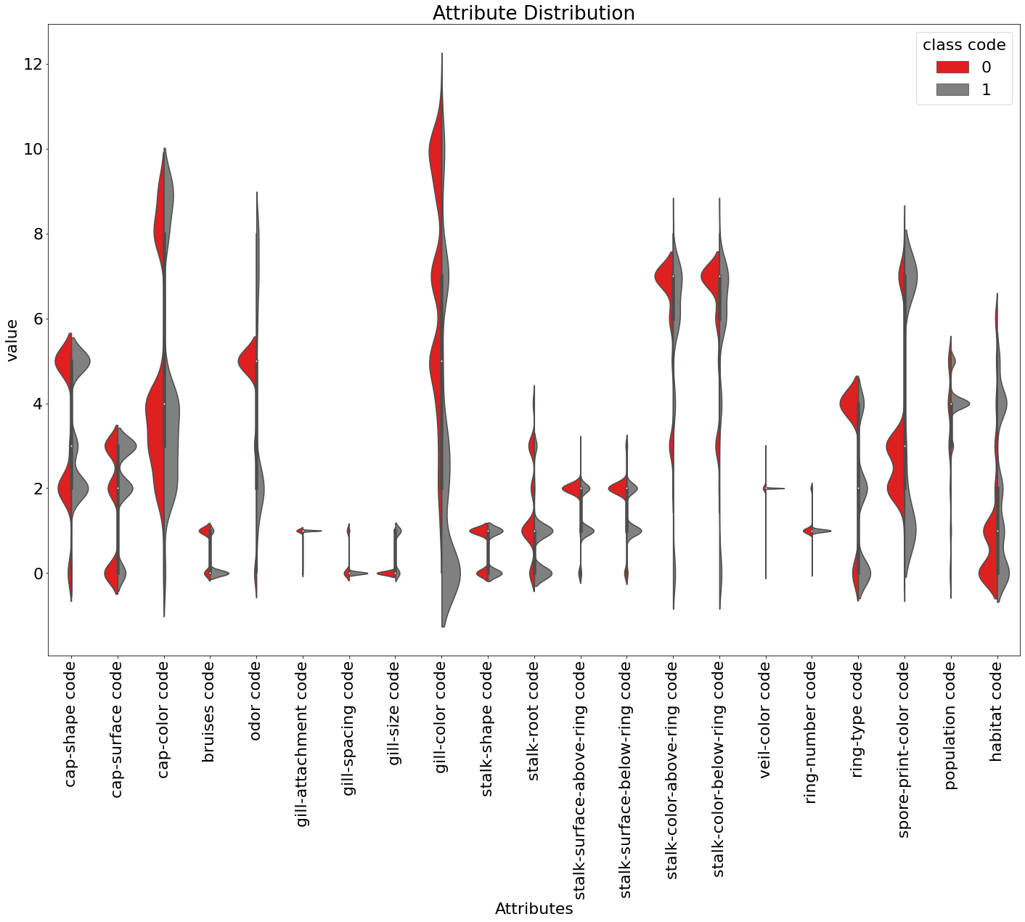
Initial Observations
Gill-Color and Odor appear to be attributes of interest
regarding stronger contributors to mushroom
classification
Class Code:
0 = Edible
1 = Poisonous
Notes:
During encoding step of preprocessing, a violinplot was constructed to explore the attribute distribution in relation to the ”class” assignment.
There was some distinct separation between “class” in attribute "gill-color" above or below a value of 3. We can also see some distinct clustering for each class in the attribute "odor" around 1-3 vs 4-6. This could be indicators that “gill-color” and “odor” may be stronger contributors to mushroom classification.

Slide 14

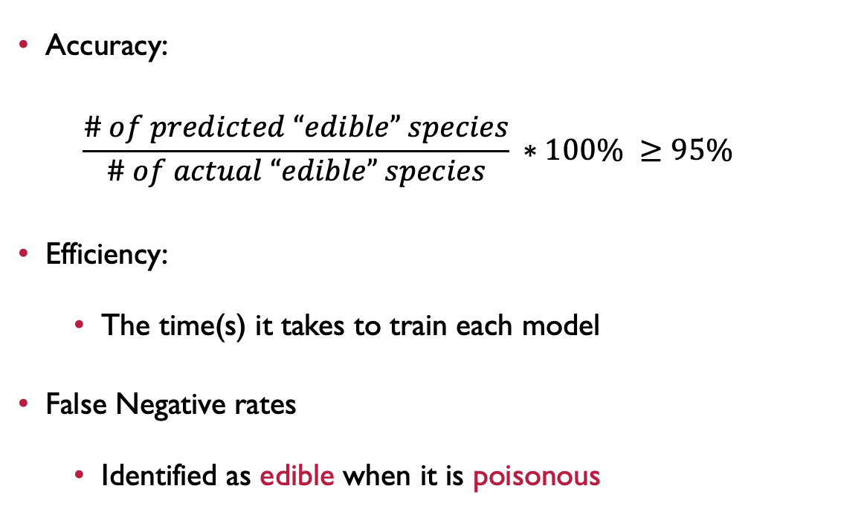
Evaluation Criteria
Accuracy:
$$\frac{\# of predicted “edible” species}{\# of actual “edible” species} ∗100\% ≥95\%$$
Efficiency:
The time(s) it takes to train each model
False Negative rates
Identified as edible when it is poisonous
Notes:
Before the models were implemented and tested, evaluation criteria was set up.
To measure accuracy, the following equation was used and evaluated against a greater than/equal to 95%
Efficiency was evaluated, comparatively by the time it took to train each model. The shortest time would be the most efficient.
Lastly, in the context of practical meaning, false negatives were also reported. In this case, a false negative would be a mushroom that was identified as “edible” when it is actually “poisonous.” This is especially relevant, since the underlying goal of this project aims to maintain the safety of foragers most accurately, and a false negative represents the most unsafe scenario.

Slide 15
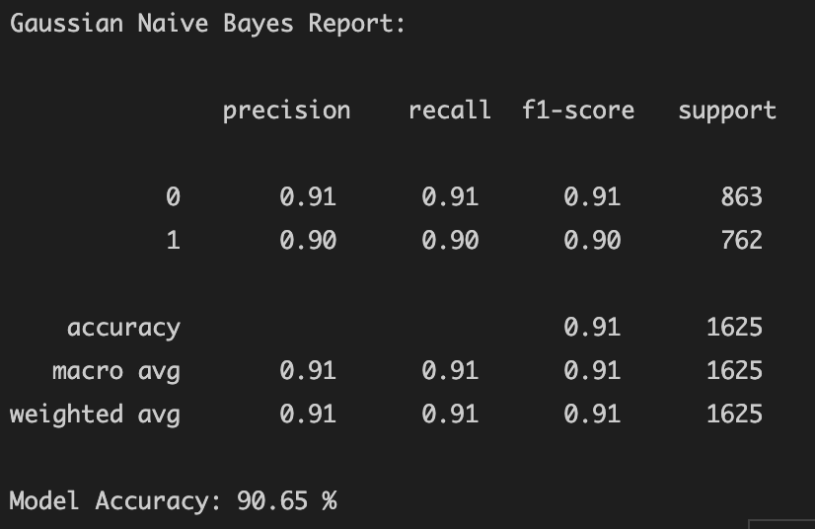
Naïve Bayes
Accuracy: 90.65%
Efficiency: 0.7 s
False Neg: 4.62%
Assumption: All attributes are independent predictors
Utilizes Bayes theorem i.e. determine the probability that a mushroom is edible or poisonous given the different attribute assignments.
Notes:
Here we have the evaluation of the Naïve Bayes model implemented. This model utilizes Bayes theorem to determine the probability that a mushroom is edible or poisonous given the different attribute assignments. One drawback about this model is that it assumes that all attributes are independent predictors. As with most real-world data, including this set, it is not always accurate to assume independence.
It has an accuracy rate of 90.65%, efficiency time of 0.7 s, and a false negative rate of 4.62%. This model had the lowest, and only failing, accuracy percentage despite being the fastest model to train.
Additionally, the specific type (Gaussian) of Naïve Bayes used is for data with continuous values. Although encoding of the attribute values made data continuous, the actual attribute values represent discrete values, which could have additionally contributed to the low comparative accuracy rate.

Slide 16
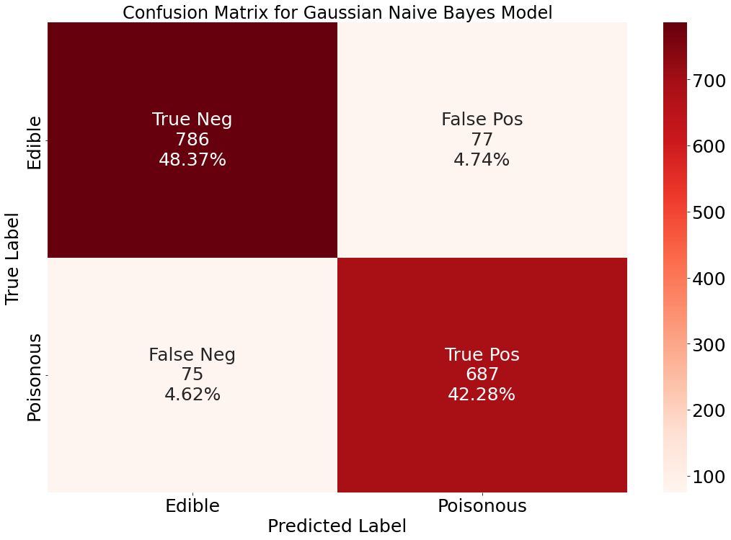
Notes:
Since this model had an accuracy rating below the acceptance criteria, a confusion matrix was constructed explore the breakdown of predictive performance. We see that the false negative rate is at 4.62%, which is not ideal considering the severity of making this error compared to a false positive error.
As a reminder a false positivity error would be the model predicting a mushroom as posionous when it is actually edible. With this high of a false negativity rate, and it's safety impact, I ruled out the Naive Bayes Classification in favor of other models.

Slide 17
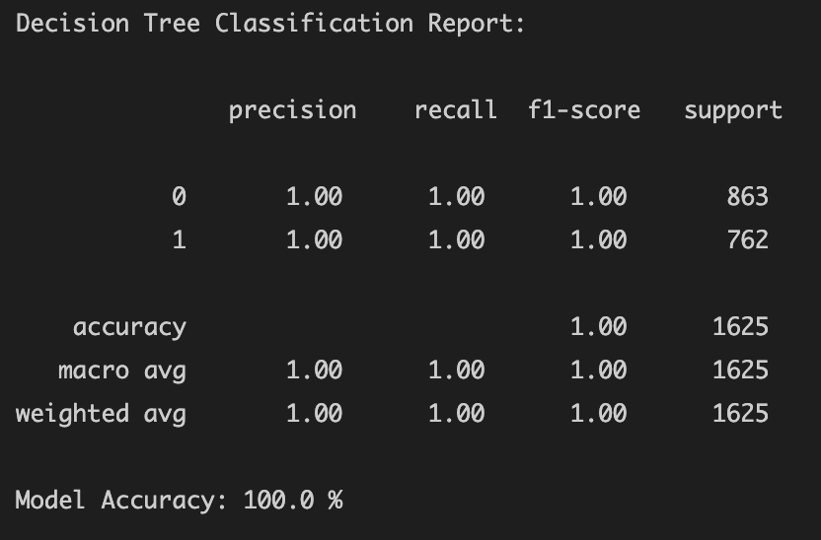
Decision Tree Classifier
Accuracy: 100.0 %
Efficiency: 2.1 s
False Neg: 0%
Assumption: Gini impurity criterion used
Utilizes greedy divide and conquer algorithm to build out splitting tree nodes in efforts to form homogenous subsets. Most important attribute identified for classification: gill-color
Notes:
Next, I evaluated the Decision Tree Classifier. This model utilizes a greedy divide and conquer algorithm to build out splitting tree nodes in efforts to form homogenous subsets. The criterion by which the algorithm makes the decision to split nodes was chosen as Gini Impurity. The impurity value is calculated as a probability that a given data is misclassified (i.e. a lower value is more desirable).
It has an accuracy rate of 100%, efficiency time of 2.1 s, and a false negative rate of 0%. Additionally, the most important attribute identified for classification was ”gill-color.” This model had ideal accuracy, mid-level efficiency timing, and an ideal false negative rate.
Some of the general drawbacks to using this model were adjusted for to improve robustness. This includes its propensity to overfitting, which was taken care of by splitting up the dataset, and SciKit-learn’s limitations of being unable to support categorical variables, which were subsequently encoded.

Slide 18
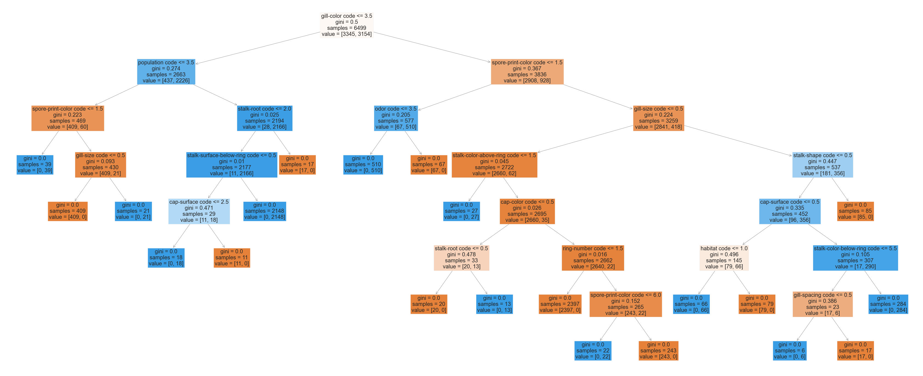
Notes:
Here is the output of the decision tree constructed for the classification of mushrooms, as you can see all the attributes are distributed throughout the nodes, with the heavier weighted attributes higher on the tree….

Slide 19
Notes:
The strongest attribute contributing to classification can be found at the root node, which in this case is “gill-color”.
And the splitting of the root node about the value 3.5 is fairl consistent with distinct separation in distribution of this attribute, as shown in the previous violin plot.

Slide 20
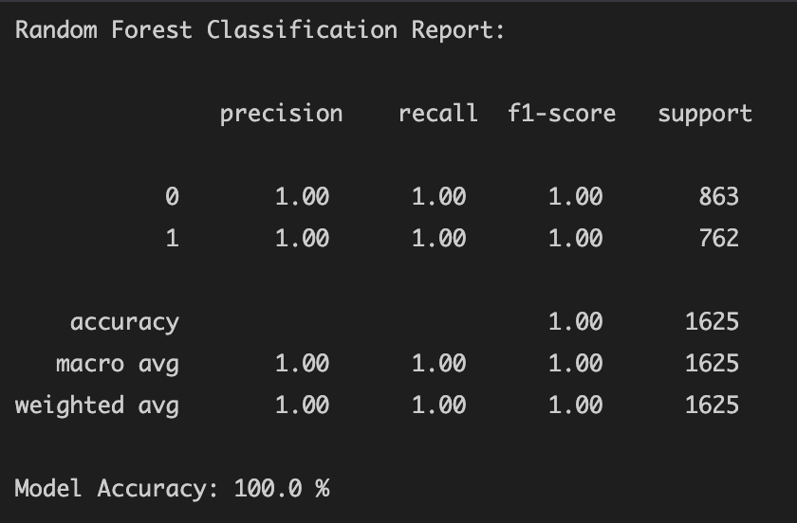
Random Forrest Classifier
Accuracy: 100.0 %
Efficiency: 4.9 s
False Neg: 0%
Assumption: Gini impurity criterion used
Combines many decision trees models to account for inherent randomness that is often observed in real-world data.
Notes:
Lastly, a Random Forrest Classifier was evaluated. This model combines many different decision trees to account for inherent randomness that is often observed in real-world data. The algorithim to implement the different decision trees remained the same from the previous model implmented, therefore Gini Impurity was maintained. This model was implemented to explore if overfitting could further be avoided through the addition of randomness and averaged combination of multiple different decision trees
It has an accuracy rate of 100%, efficiency time of 4.9 s, and a false negative rate of 0%.” This model had similar ideal accuracy and false negativity rate but took the longest time to train.

Slide 21
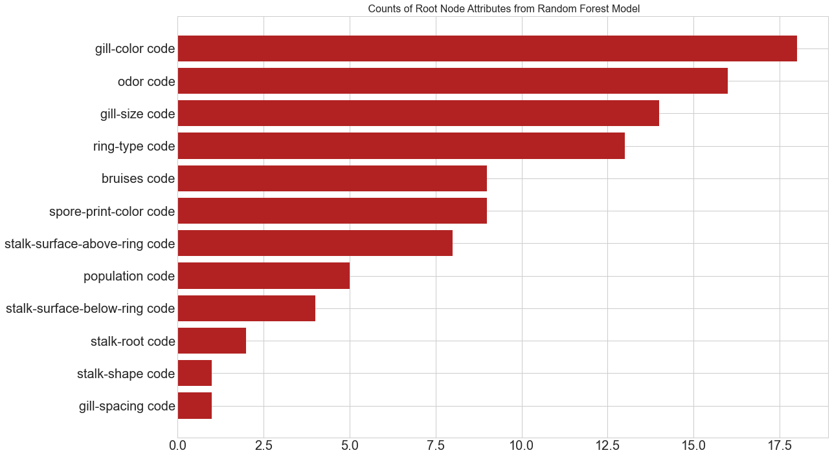
Notes:
The most important attribute was assigned to root node of each decision tree, therefore a breakdown of root node attribute distribution was explored. This yielded consistent results with previous observations, “gill-color” was the top count, followed closely by “odor.”
This provided additional confidence in the construction of the singular Decision Tree Classifier model previously. It’s high accuracy results in combination with confidence gained from real-world simulated randomness put the Random Forest Classifier as a contender for the best fit model. However, with the addition of that confidence, some efficiency was sacrificed since training this model took twice as long than the Decision Tree Classifier. In terms of practical application, a faster model (with the same accuracy) is likely going to be more appealing for the end user.

Slide 22
Conclusion
Decision Tree Classifier produced highest combined accuracy (100%) and efficiency with key attribute identified as gill-color
Future work
- Implement more efficient algorithm (less greedy)
- Retrain model with new classification data as it becomes available (increase robustness)
Notes:
In conclusion, the Decision Tree Classifier was identified as the best fit model for the classification of Mushrooms with an accuracy level of 100% and the key attribute identified as gill-color.
Some future work that can be explored further include:
Implementing a more efficient algorithm that is less greedy and therefore takes less time to train and subsequently,
Continue to retain the model with new classification data as it becomes available to increase robustness of the model

Slide 23
Project Timeline
Project proposal report ~ 1 week
Data mining and implementation of models ~ 1-2 weeks
Formalization of report/presentation ~ 1 week
Notes:
Finally, the project timeline was broken down as follows over the course of 4 weeks:
1 week was dedicated to writing the bulk of the project proposal
1-2 weeks was used to perform data mining and implementation of the models
And the final week was spent formalizing the report and presentation

Slide 24
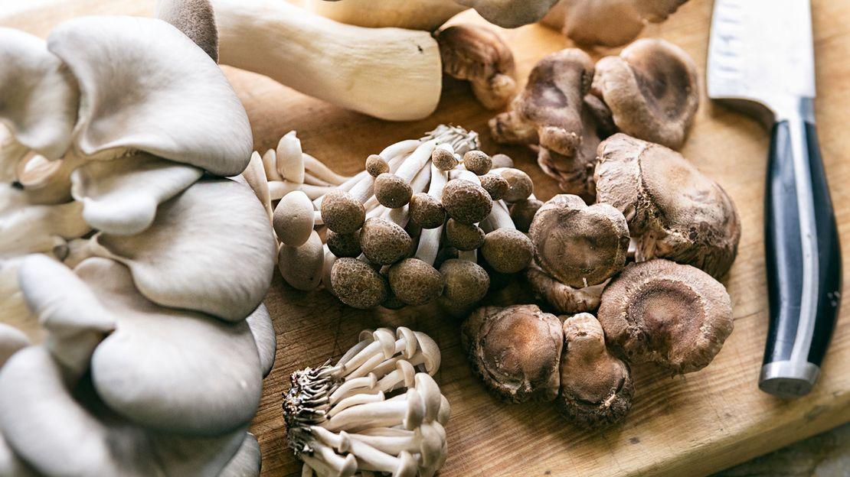
Thank you!
Notes:
And with that, that wraps up my presentation of the classification of mushrooms. I learned a lot about the data mining process and am grateful for this opportunity to utilize the knowledge that was gained throughout this specialization. I hope you enjoyed this presentation and thank you for watching!

